Slide 1
Linked list

Slide 2
Basics
Dynamic memory allocation
new and delete

Slide 4
Basics
Structures
‘ . ’ operator
-> operator

Slide 5
Linked List

Slide 8
Traversing a Link List

Slide 9
Adding to the end of Link List

Slide 10


Inserting a Node in the middle
Assume, we want to insert a value of 50 between 65 and 34

Slide 11
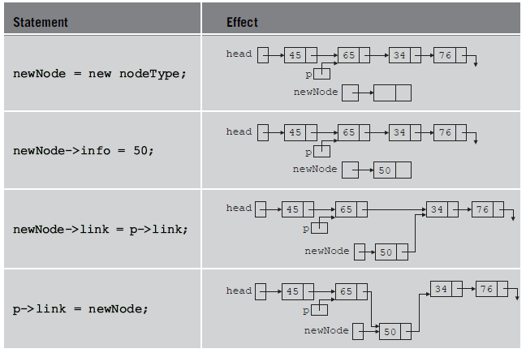

Slide 12
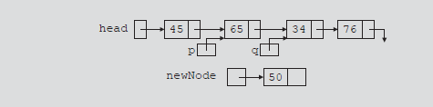
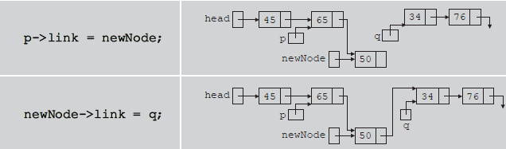
Another approach for insertion

Slide 13
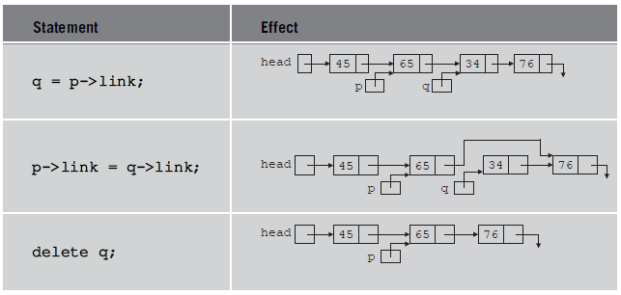
Deleting a Node
Assume, we want to delete a node with value of 34

Slide 14
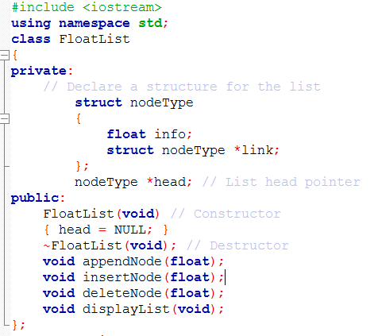
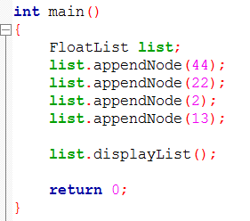
Link List class for storing float values

Slide 15
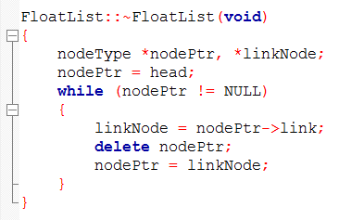
Destructor

Slide 16
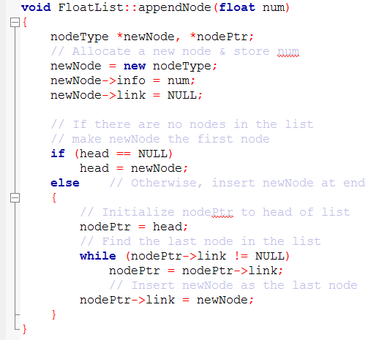

Slide 17
Assignment operator support for classes
Assignment operator can be used to assign values from one object to other object of same class
We do not need to overload the assignment operator. C++ will itself do a member wise copy
Example
Distance d1(4,5), d2(2,1);
d1=d2; //now d1 carries 2,1
What if we do
FloatList list1, list2;
//assuming list1 and list2 have some values
list1 = list2;
class Distance
{
int feet;
int inches;
}

Slide 18
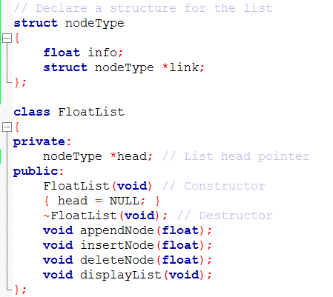

Slide 19
Assignment operator in Link List class
Link List class has a head pointer as data member
Nodes are dynamically created afterwards
Example
linklist a,b;
a.append(4);
a.append(8);
a.append(1);
b=a;
Lets draw it
We need to overload assignment operator for cases, where pointers are to be copied

Slide 20
Assignment Operator Overloading for FloatList class

